Slide 1

Programming One (csc7050)
Aidan McGowan
OOP - Constructors

Slide 2
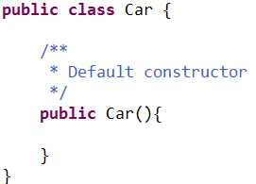
Constructors
A class contains constructors that are invoked to create objects from the class blueprint.
Constructor declarations look like method declarations—except that they use the name of the class and have no return type.

Slide 3
Constructors – an example
Every class must have at least one constructor. If you do not provide any in a class’s declaration, the compiler creates a default constructor that takes no arguments when it’s invoked.
The default constructor initialises the instance variables to the initial values specified in their declarations or to their default values (zero for primitive numeric types, false for boolean values and null for references).

Slide 4
Constructors - default
Consider the following class – representing a professional Footballer
Footballer
firstName: String lastName : String squadNumber : int employeeNumber : int
Getters and Setters for above vars

Slide 5
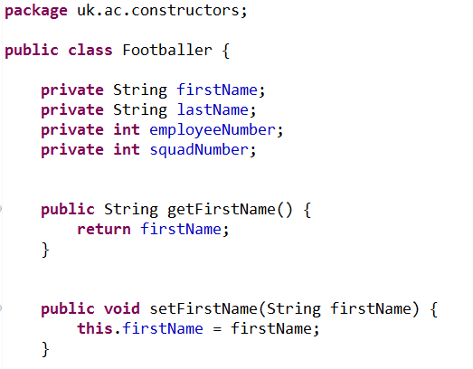
Footballer class
Instance variables.
Getters and setters
(note not all shown here!)

Slide 6

Default constructor
Remember : Every class must have at least one constructor. If you do not provide any in a class’s declaration, the compiler creates a default constructor that takes no arguments when it’s invoked.
So where is it ?

Slide 7
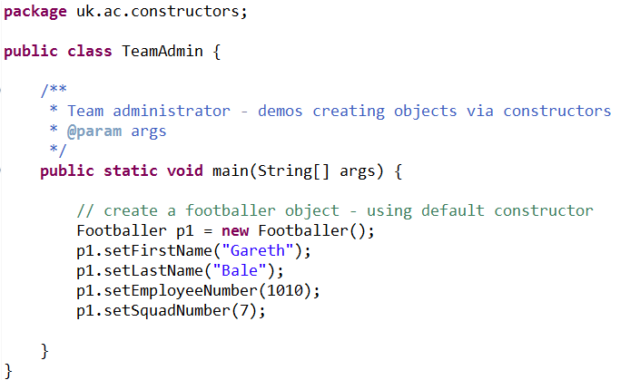
Creating the footballer using the default constructor
Creating the class via the default constructor
Setting instance variables.

Slide 8
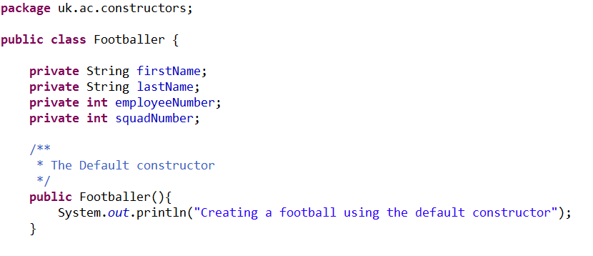
Manually adding the default constructor
The default is added automatically but it is not visible in the code.
The default constructor

Slide 9
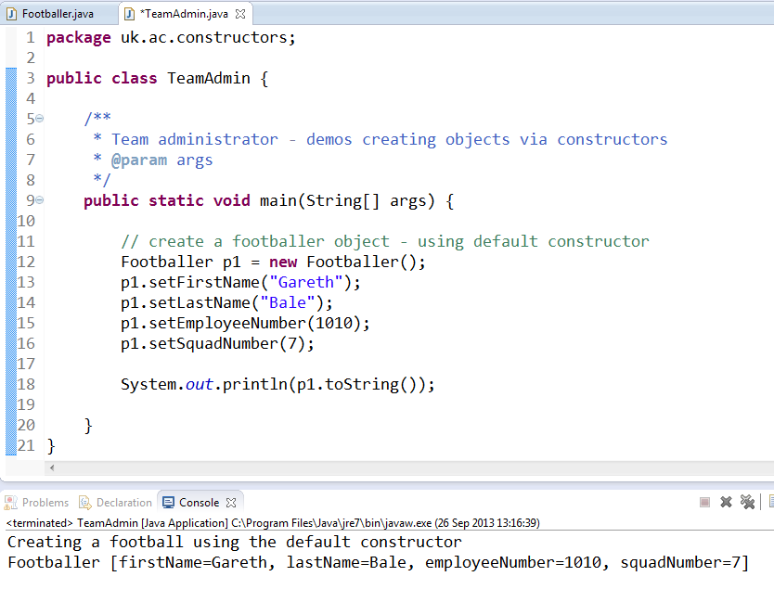
Just to prove it …

Slide 10


Constructor exercise I
Create the following class to represent a Book in a Library system and instantiate two objects of the class. Add a default constructor – and include an output statement “creating a book object” in the constructor.
Book
title: String
Getter and Setter for above instance variable

Slide 11
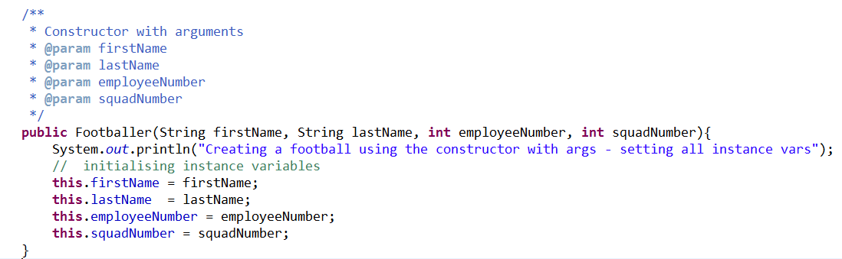
Constructor with arguments
Used to initialise the instance variables of the object.

Slide 12
this keyword
Within an instance method or a constructor, this is a reference to the current object — the object whose method or constructor is being called. You can refer to any member of the current object from within an instance method or a constructor by using this.
Within the constructor the keyword this is used to refer to the instance member of the class. But commonly the parameter reference is named the same !

Slide 13
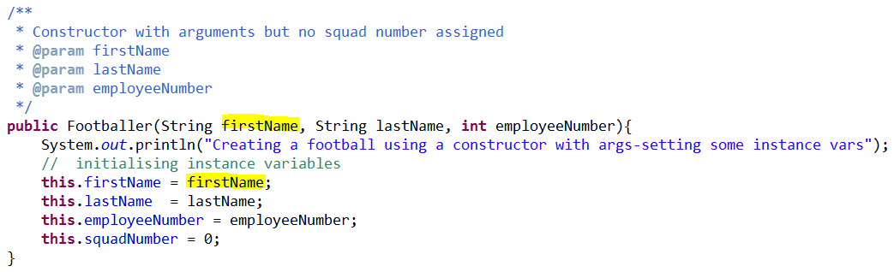
Do you mean this or this ?
Parameter name is firstName
firstName here refers to the parameter name
this.firstName refers to the instance variable declare elsewhere in the class

Slide 14
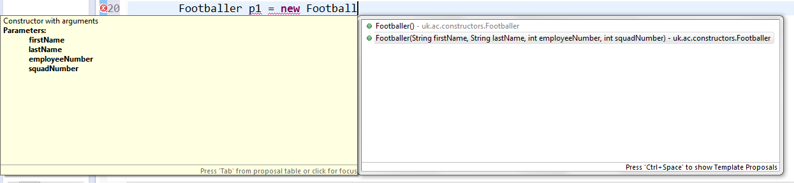
Using a constructor with arguments
When accessing there are now two options…

Slide 15
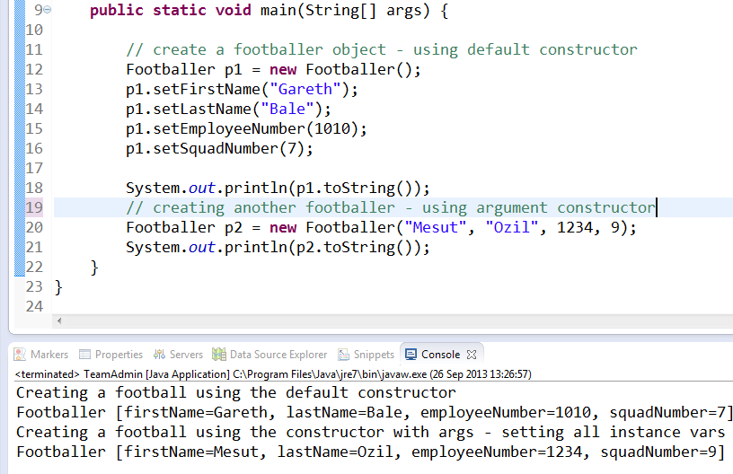
Using constructor with arguments to create object

Slide 16

Constructor with arguments
If you add an argument based constructor the default is over written !
So it’s a good idea to add one regardless..

Slide 17


Constructor exercise II
Update the Book class to include a Constructor with one argument, namely the book title. Create another two book objects but with this new constructor.
Book
title: String
Getter and Setter for above instance variable

Slide 18
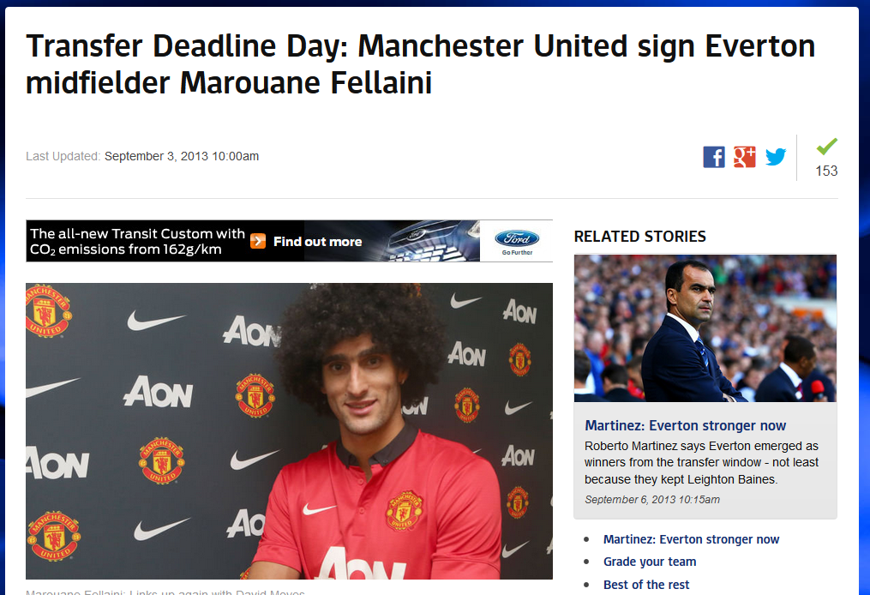
LastMinute.com !
David Moyes - “Quick get him registered !”
Man U Admin – “what about the squad number?”
David Moyes– “I don’t have it yet” ☹

Slide 19
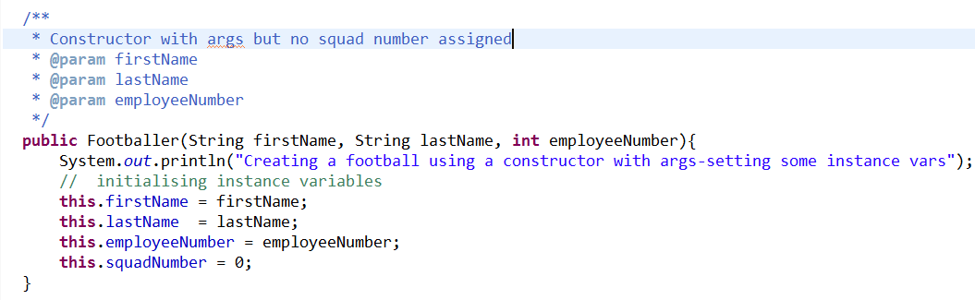
Overloading …
Similar to overloaded methods, constructors can have various arguments …

Slide 20
Overloaded constructor

Slide 21
Benefits of constructor with arguments
Create objects and initialise values in one go.
Quicker for programmer
Quicker for application – less operations.
Less testing
Control …

Slide 22
Control of variable initialisation
Constructors can be used to control, for example to apply business rules to the creation of the objects.
For example in football class – there would normally be a limited number of available squad numbers.
This could be controlled in the constructor to ensure that only an available is used…

Slide 23

Control of variable initialisation
Static variable (shared between all instance of the Football objects)

Slide 24
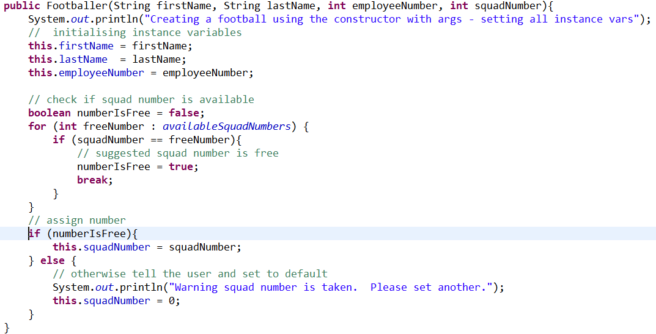
Updated constructor – now controls the squad number allocation
Check if the suggested number is available by cycling through the available numbers
Note use of enhanced for loop
Number is free then assign
Number not free – let user know and set the default

Slide 25

Control of variable initialisation
– updated program run

Slide 26
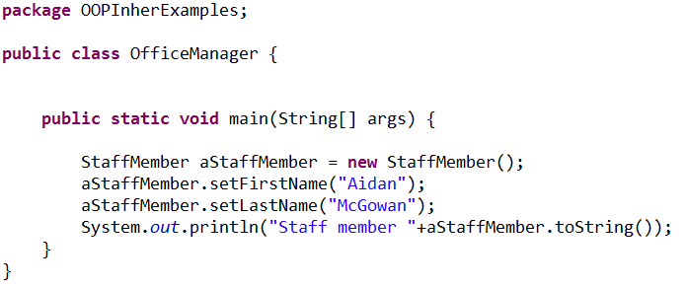
Previously – default constructor
Summary example
Consider previously we created the StaffMember class using the default (no arguments) constructor

Slide 27
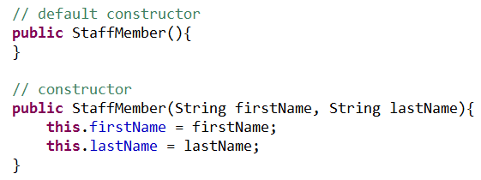
Update with constructor with arguments
Remember to include a default constructor as it will be overwritten as soon as you create one with arguments !

Slide 28
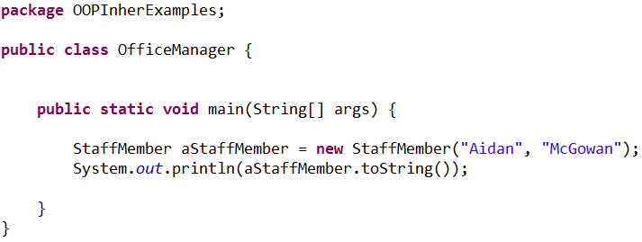
Using the constructor with arguments
So now we have the option to create the object and pass in the instance variable details at the same time

